Slide 1
Student Outcomes
Predicting College preparedness by analyzing public school and student assessment data
Kyle Davis
UCD Data Analytics Bootcamp
August 2019

Slide 2
Data Sources – SARC datasets
CA High School Exit Exam Scores
School Enrollment Data
UC Preparedness Rates
Graduation Rates
Dropout Rates
SAT, ACT and AP Scores
Each of these datasets uses a unique code to identify each school – a 14 digit “CDS code” which is comprised of elements that identify a school’s county, district, and school name:
County – First 2 elements District – Next 5 elements School – Next 7 elements
Example:
01 61119 013229
identifies Alameda High School in the Alameda City Unified School District in Alameda County, California.

Slide 3
Goal – Questions we seek to answer
To establish a model to be able to predict the measure of increase in student college preparedness based on the influence of various data features.
For example: How does increasing the number of students taking the SATs influence the rate of students meeting college admittance requirements? How about Student size? Or the student body demographic make-up?

Slide 4
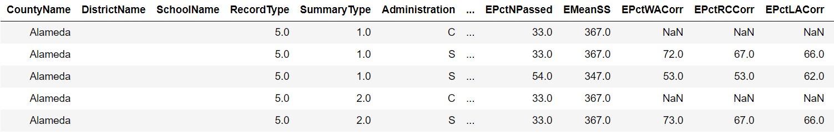
CAHSEE Data
CAHSEE Data
Dataset containing information on CA High School Exit Exam Pass Rates

Slide 5
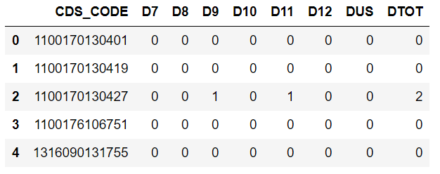
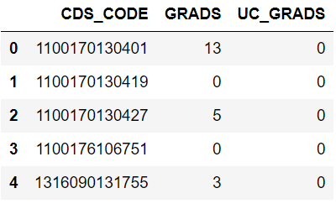
Graduation and Dropout Rates
Dropout Rates
Graduation Rates
Information on dropout rates of each grade level, as well as graduation rates, and UC preparedness rates of each school.

Slide 6
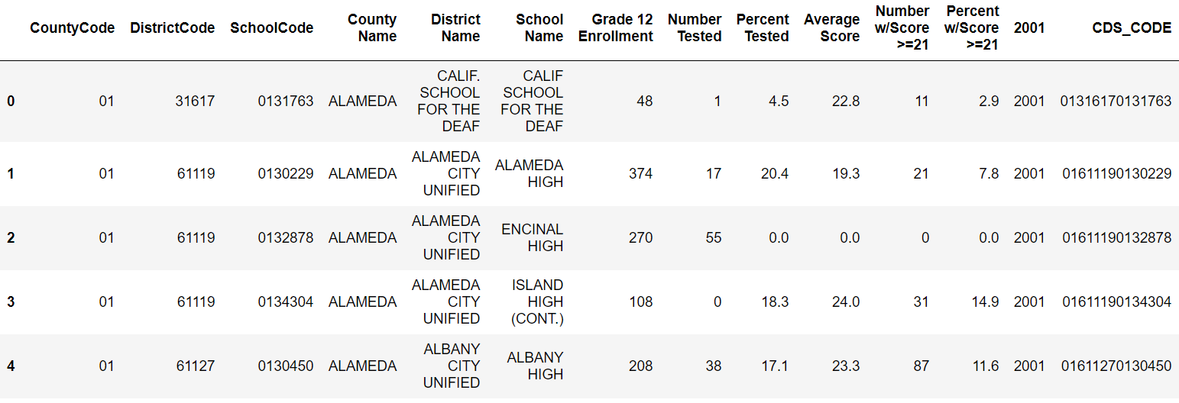
ACT TEST Data
ACT Data
Dataset containing information on ACT scores

Slide 7
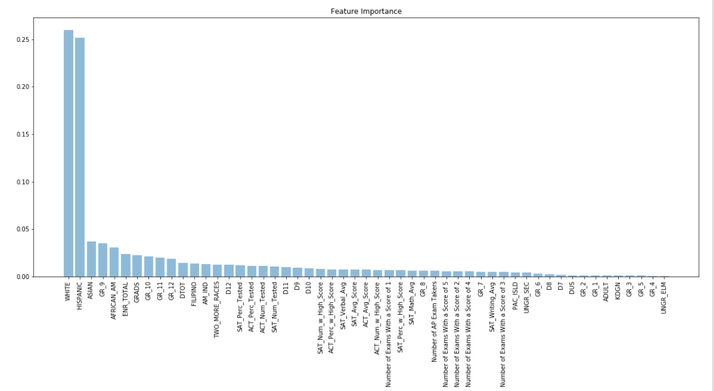
Plotting The Importance of each feature

Slide 8
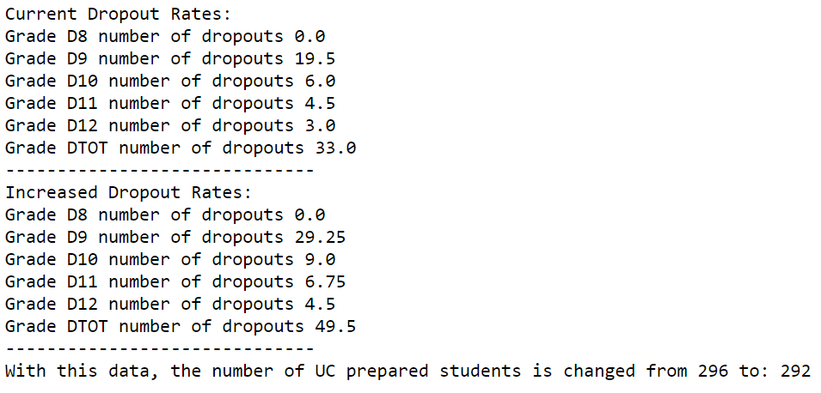
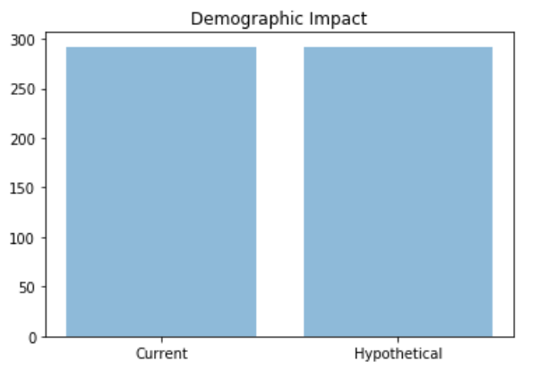
Predicted data
Hypothetical – Increase Dropout Rates by 50%, or 11 Students
As expected, an increase in dropout rates reduces the number of students meeting the college prep guidelines

Slide 9
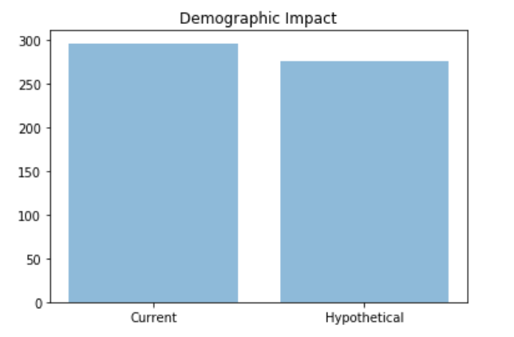
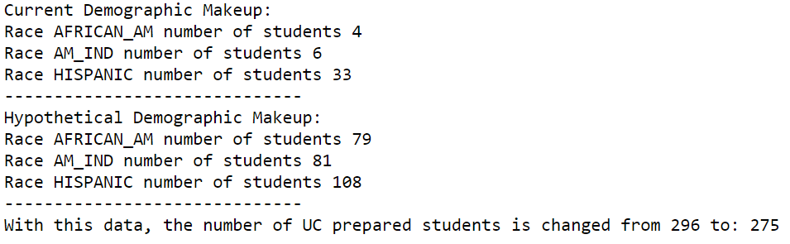
Predicted data
Hypothetical – Increase Typically Lower Socioeconomic Student Enrollment by 300 Total
A targeted increase in demographic make-up of the student body has a significant impact on the UC readiness of the students in the school.

Slide 10
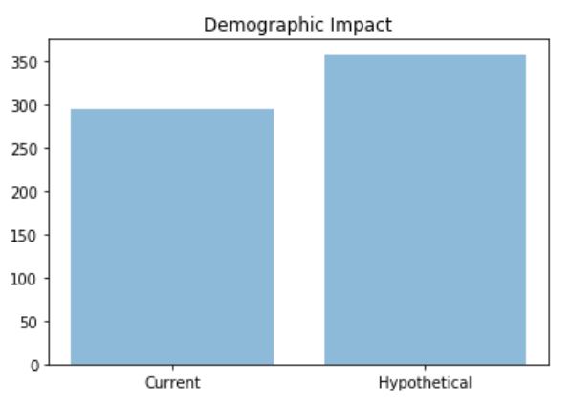
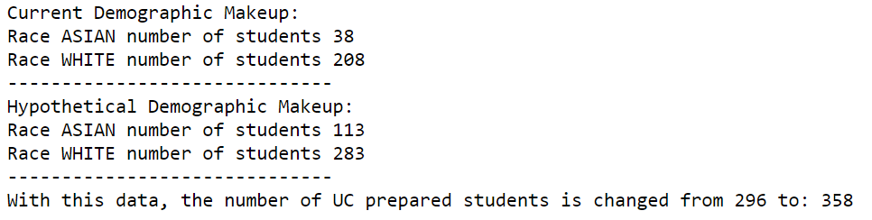
Predicted data
Hypothetical – Increase Highest Performing Demographic Student Enrollment by 300 Total
A targeted increase in demographic make-up of the student body has a significant impact on the UC readiness of the students in the school.

Slide 11
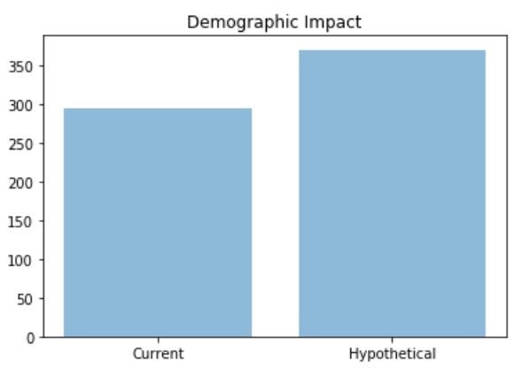
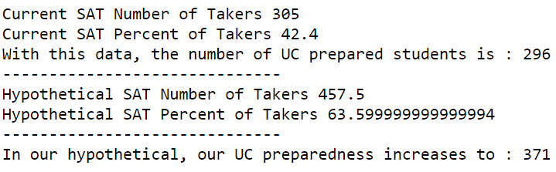
Predicted data
Hypothetical – Increase the number of students taking the SAT by ~21 percentage points, or 50% of the current rate.
A targeted increase in the number of students taking the SAT has a significant impact on the UC readiness of the students in the school.

Slide 12
Applications
Advise specific schools of ways they can increase college preparedness rates.
Identify which schools can rely on an increase of SAT/ACT test takers increasing their college preparedness.
Help governmental and charitable organizations identify where to focus their efforts (lower sociodemographic areas, increased SAT/ACT test rates, etc.).

Slide 13
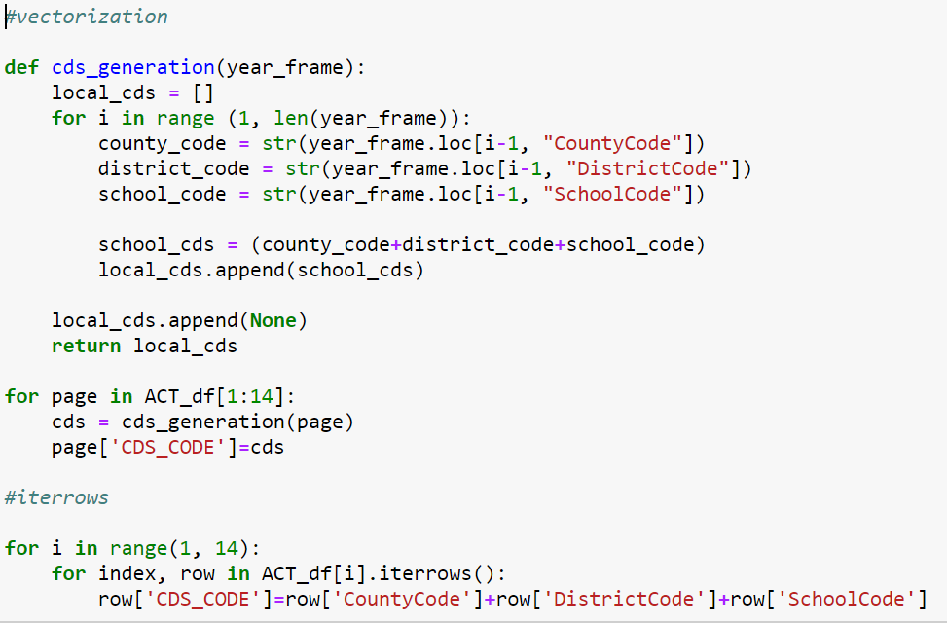
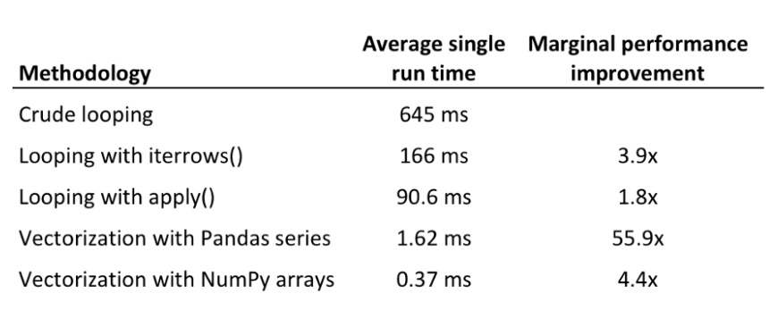
Roadblocks
Vectorization vs. df.iterrows()

Slide 14
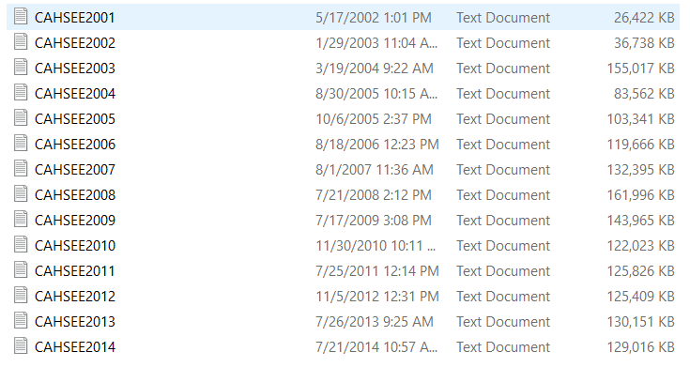
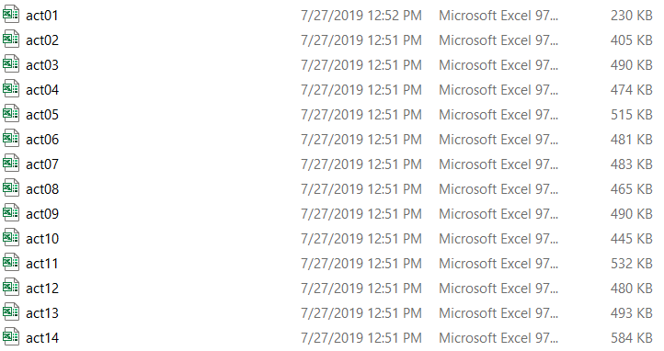

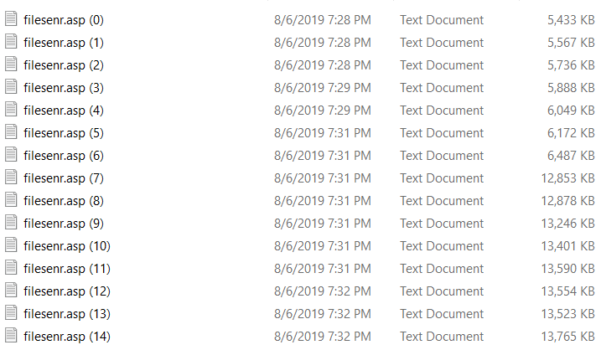
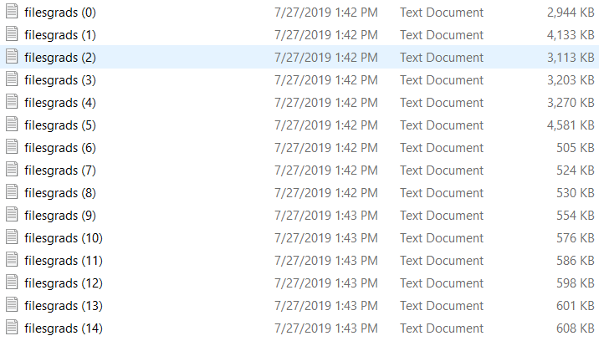
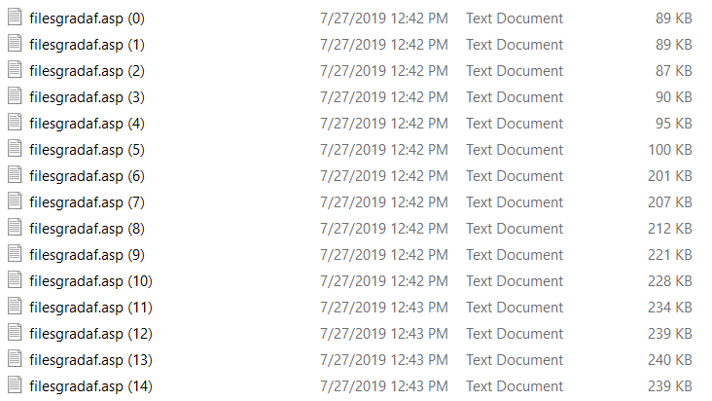
Roadblocks
Different file types

Slide 15
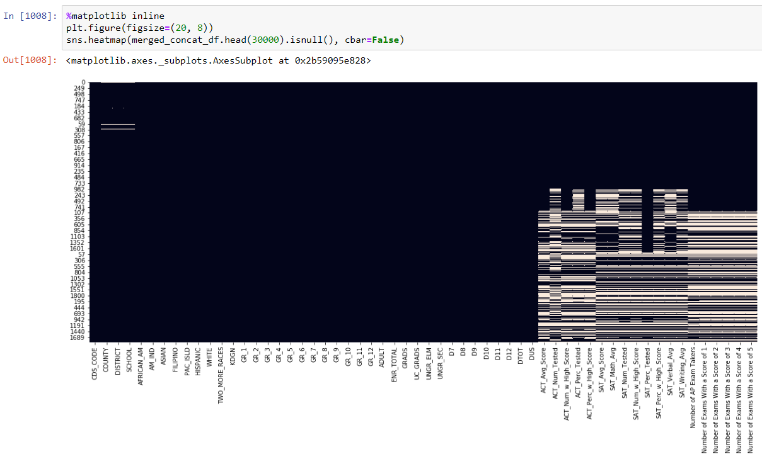
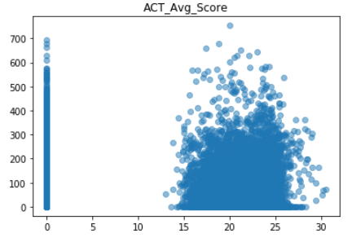
Roadblocks
Dealing with NaN values

Slide 16
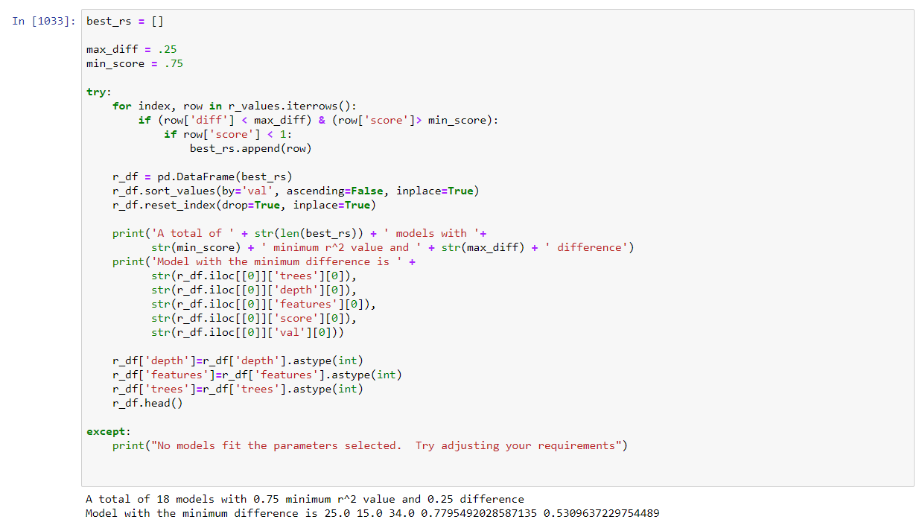
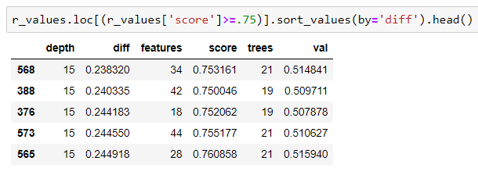
Roadblocks
Finding optimal R^2 score

Slide 17
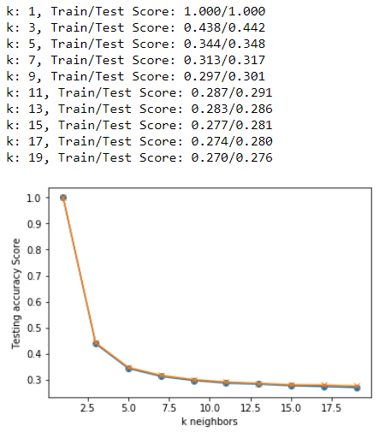
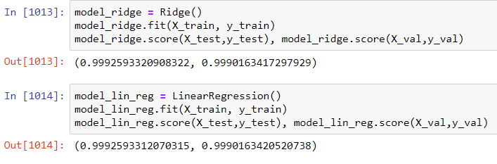
Roadblocks
Trying other models

Slide 18
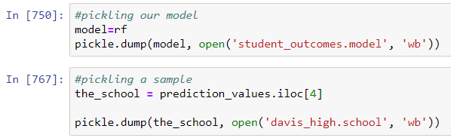
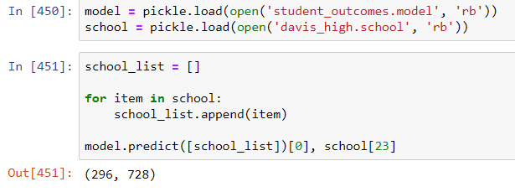
Roadblocks
Preserving and testing a model

